Slide 1

MUSIC INDUSTRY DATA ANALYSIS
USING SQL
Data-Driven Insights & Growth Analysis
Presented by YOGESH ADHANA

Slide 2


Objective of
MUSIC DATA ANALYSIS
To analyze music store sales data using SQL in order to identify revenue drivers, customer behavior, and genre trends, and translate data findings into actionable business insights.

Slide 3
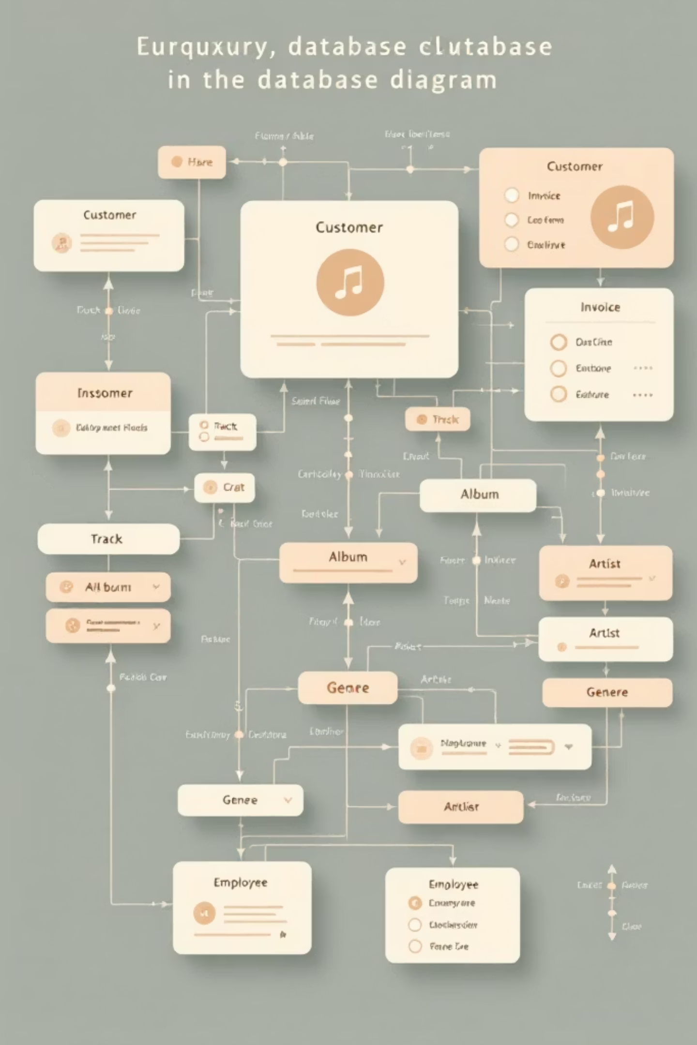
DATA OVERVIEW
MUSIC INDUSTRY DATA SCHEMA
Customer
Geographic Distribution
Customer details and demographics
Customers distributed across multiple countries and cities
Extensive Purchase History
Invoice
Purchase data covering hundreds of invoices and transactions
Purchase transactions and billing information
Vast Music Catalog
Thousands of music tracks spanning multiple genres
InvoiceLine
Diverse Artists & Albums
Individual items within each invoice
Wide range of artists and albums represented
Granular Sales Data
Track
Detailed track-level sales records enabling granular analysis
Song-level details
Relational Connections
Genre, artist, and customer data connected through a relational schema
Album
Album information
Artist
Artist details
Genre
Music categories
Employee
Store employee data

Slide 4

Conclusion & Next Steps
Key Takeaways
Next Steps
SQL is crucial for deep dive analysis into music sales data.
Identified top-spending cities (e.g., Prague) and customers (e.g., Helena Frost) for targeted initiatives.
Rock music is a dominant genre, with specific artists driving significant engagement.
Employee hierarchy insights support operational structuring.
Plan and execute a promotional music festival in Prague to reward and attract top customers.
Develop tailored marketing campaigns focusing on rock music listeners and their preferred artists.
Engage with top-performing rock artists for potential partnerships and exclusive content.
Continuously monitor sales, customer behavior, and genre trends to inform future business strategies.

Slide 5
Advanced SQL Analysis
Actionable Business Recommendations
Translating data insights into strategic initiatives for growth and customer engagement.
Target Geographic Hotspots
Cultivate High-Value Customers
Capitalize on Genre Trends
Focus marketing and promotional efforts on cities and countries with the highest invoice totals, such as Prague, USA, and Canada, to maximize returns on localized campaigns and potential event planning.
Launch targeted campaigns and curated content around popular genres like Rock, featuring top-performing artists. This can include specialized playlists, merchandise, and genre-specific events to attract and engage enthusiasts.
Develop an exclusive VIP or loyalty program for top-spending customers. Offer personalized recommendations, early access to new music, or special discounts to enhance retention and encourage further purchases.

Slide 6
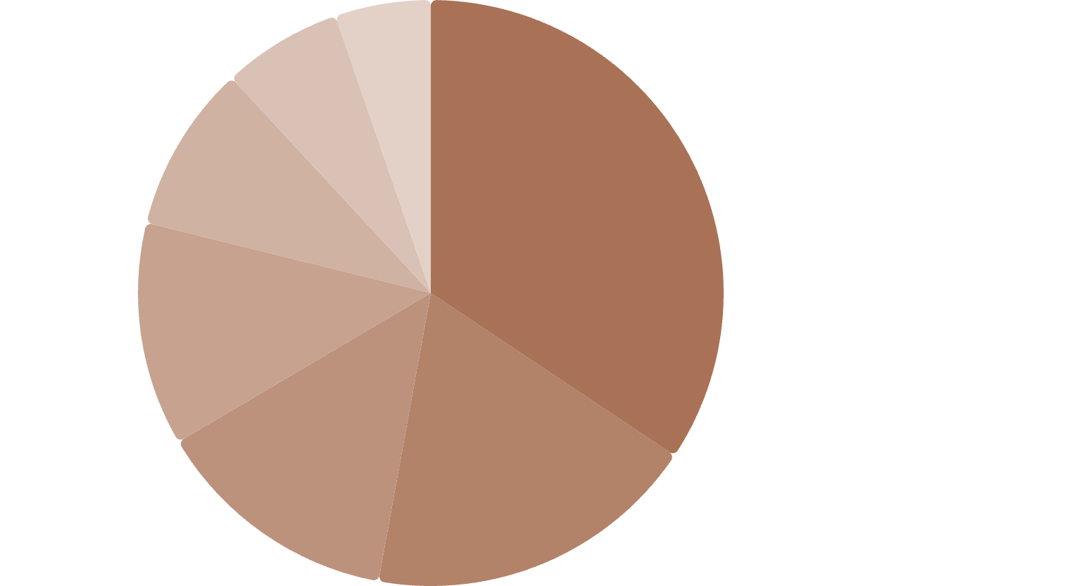

Genre Trends & Music Preferences
Top Performing Genres by Sales Volume
Rock·34.36%
·34.36%
·
Metal·18.5%
·18.5%
·
Jazz·13.66%
·13.66%
·
Latin·12.33%
·12.33%
·
Blues·9.25%
·9.25%
·
R&B·6.61%
·6.61%
·
Classical·5.29%
·5.29%
·
Analysis of sales data reveals that Rock music remains the dominant genre, generating the highest revenue for the store. Metal and Jazz also show significant sales, indicating diverse customer preferences.
Dedicated Rock Listeners
Top Rock Artists
Our data identified numerous customers with a clear preference for Rock music. These listeners are crucial for targeted promotions and fostering a strong community. Their engagement is key to driving sales in this top genre.
To capitalize on the popularity of Rock, we identified the artists with the most tracks sold. These top performers are prime candidates for collaborations and exclusive content to further boost sales.
1
Led Zeppelin
Engaged Audience
114 tracks
Consistent purchasers of rock albums and tracks.
Deep Purple
Global Reach
2
94 tracks
Rock music listeners span across various countries.
3
Iron Maiden
81 tracks
4
Pearl Jam
54 tracks
5
Van Halen
52 tracks

Slide 7

Customer Segmentation & Behavior
Understanding Value & Engagement
Analyzing customer spending patterns allows us to identify and categorize our most valuable customers, tailor marketing strategies, and optimize service offerings.
Platinum Tier
Our highest-spending customers, often with exclusive access and personalized experiences.
Gold Tier
Valued customers with significant spending, benefiting from premium rewards and early access.
Silver Tier
Regular and engaged customers forming the core of our loyal client base.
Bronze Tier
New or occasional customers, representing growth potential through targeted engagement.

Slide 8
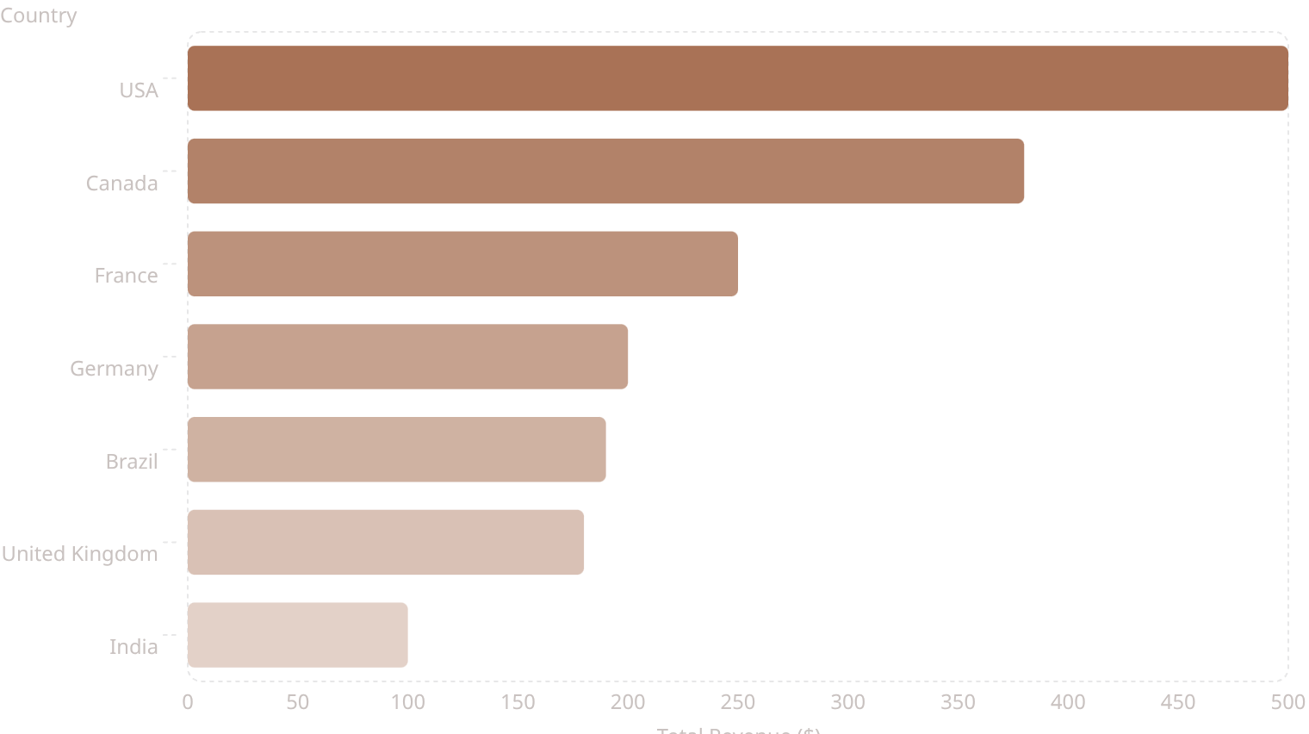
Advanced SQL Analysis
Revenue Analysis by Geography
Identifying key markets and top-performing countries based on total invoice value to inform future promotional strategies.
The bar chart clearly indicates that the USA and Canada are our leading revenue generators, contributing significantly more than other regions. France and Germany show strong performance in Europe, while Brazil is a prominent market in South America. These insights are crucial for targeting marketing efforts and planning regional music events.

Slide 9
CONCLUSION
Key Findings & Insights
Our SQL analysis uncovered critical patterns in sales, customer behavior, and musical preferences, providing a foundation for strategic business decisions.
Geographic Sales Focus
High-Value Customer Hubs
Specific countries like the USA, France, and Germany demonstrate significant sales volume, indicating strong regional markets for targeted expansion.
Cities such as Prague show the highest invoice totals, making them prime locations for promotional events and localized marketing efforts.
Genre-Specific Audiences
Influential Artists & Content
Identification of loyal listeners for genres like Rock Music enables personalized content recommendations and community building initiatives.
Top artists contributing the most tracks within popular genres are key partners for exclusive content and music festival invitations.

Slide 10

Thank You
Questions & Discussion
YOGESH ADHANA
Email: yadhana12@gmail.com
LinkedIn: /yogesh-adhana-682ab5164

